Slide 1

Database Systems MongoDB Assignment
Harsha Mangnani Fatima alsaadeh

Slide 2

NoSQL database

Slide 3

ubuntu@ip~$ssh -i "ub1.pem" ubuntu@ec2-18-222-31-5.us-east-2.compute.amazonaws.com ubuntu@ip~$sudo apt-get update ubuntu@ip~$wget -qO - https://www.mongodb.org/static/pgp/server-4.2.asc | sudo apt-key add - buntu@ip~$echo "deb [ arch=amd64 ] https://repo.mongodb.org/apt/ubuntu bionic/mongodb-org/4.2 multiverse" | sudo tee /etc/apt/sources.list.d/mongodb-org-4.2.list ubuntu@ip~$sudo apt-get update ubuntu@ip~$sudo apt-get install -y mongodb-org ubuntu@ip~$sudo service mongod start
Deploy to ec2

Slide 4

select user_id, o.order_id, order_number,
order_dow, order_hour_of_day,
reordered, add_to_cart_order,
days_since_prior_order,
p.product_id, p.product_name,
a.aisle, a.aisle_id, d.department_id, d.department
INTO orders_denorm
from orders o
JOIN order_products op
on o.order_id= op.order_id
JOIN products p
on op.product_id= p.product_id
JOIN aisles a
on a.aisle_id=p.aisle_id
JOIN departments d
on d.department_id=p.department_id
Denormailzed table

Slide 5
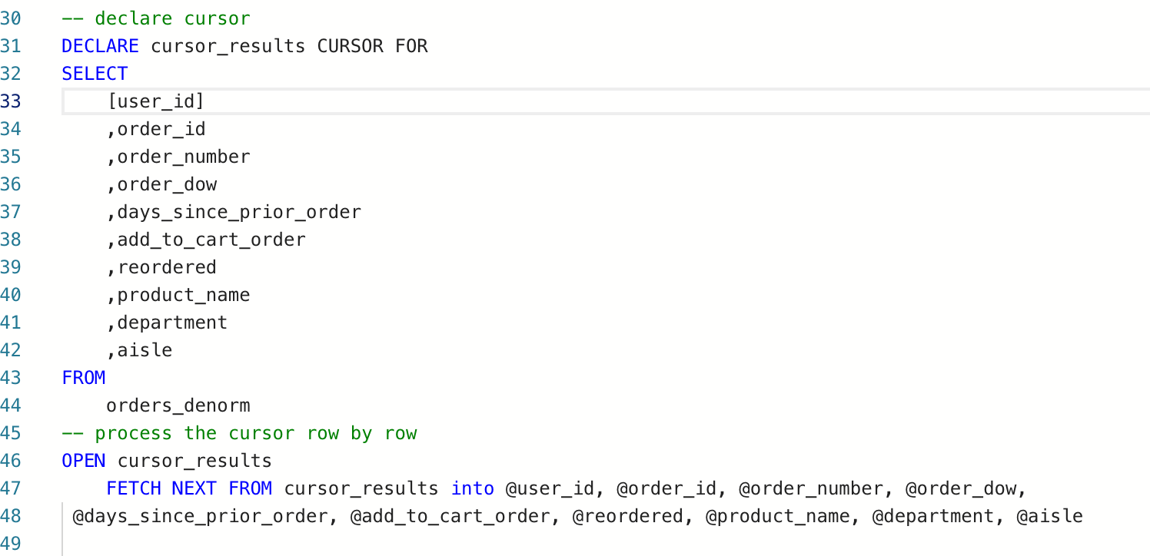

Slide 6
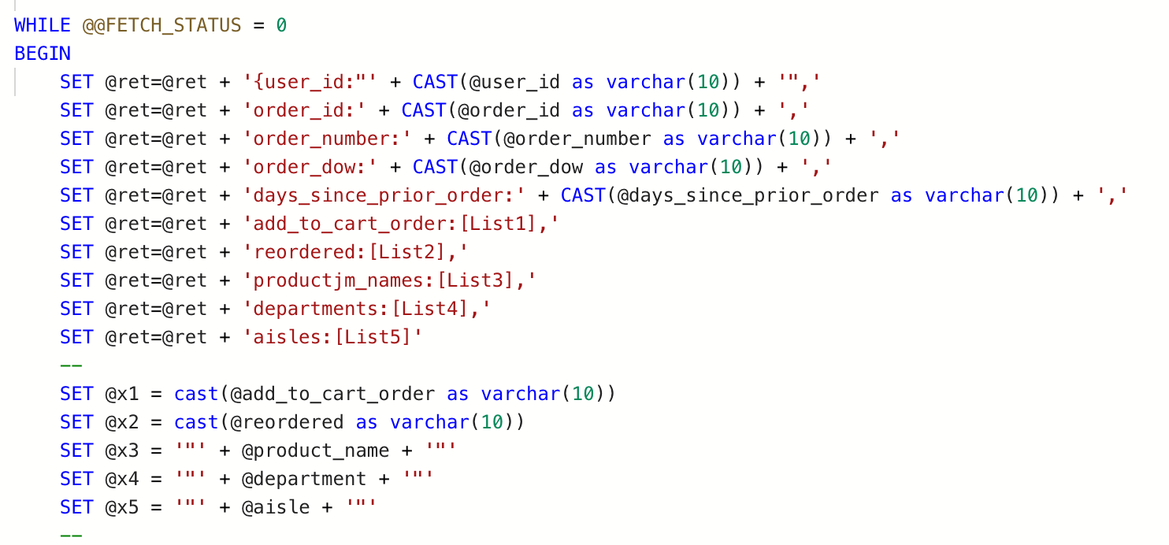

Slide 7
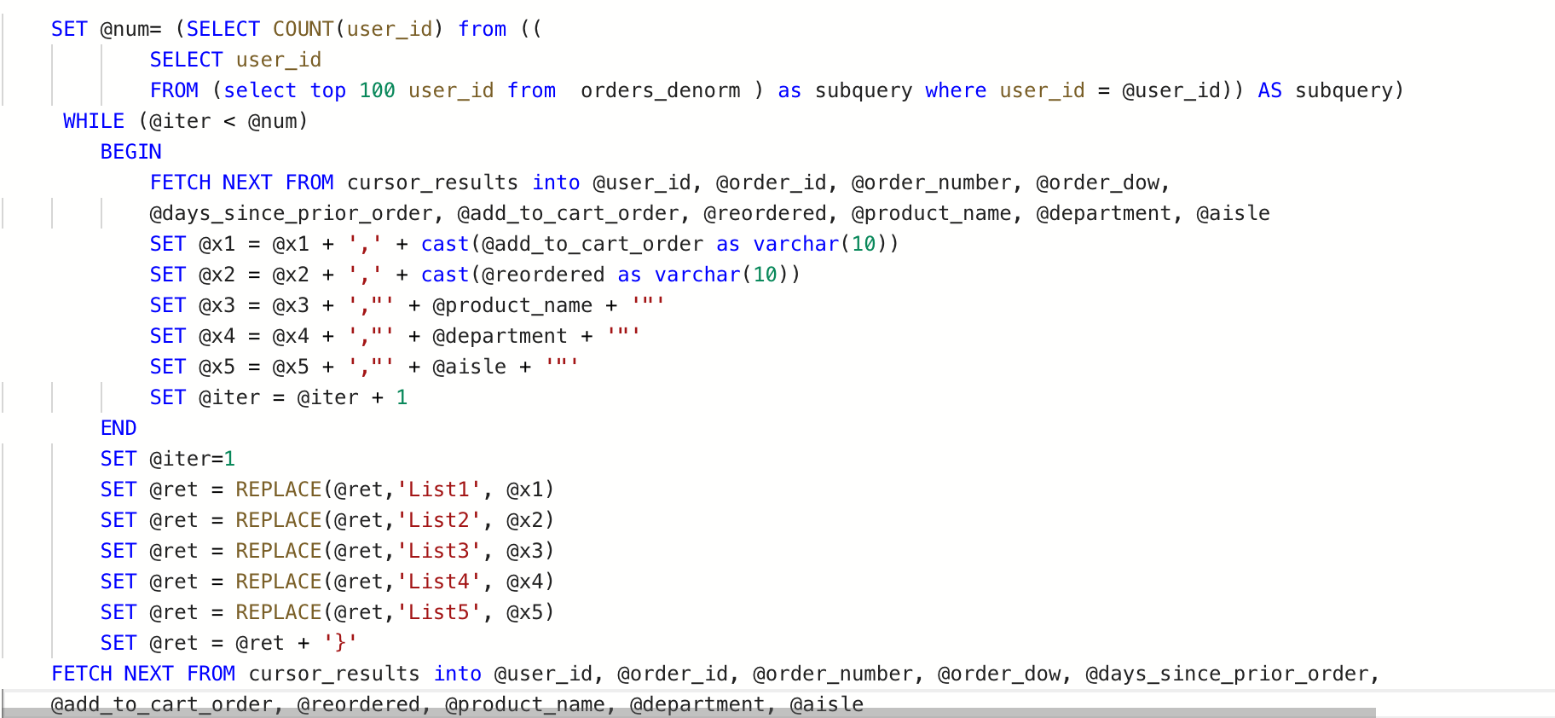

Slide 8
CREATE PROCEDURE GetJSONformat
AS
SELECT a.aisle_id 'Aisle_id',
a.aisle 'Aisle',
product_id 'ProductID',
product_name 'Product_name'
FROM products p, aisles a
WHERE a.aisle_id = p.aisle_id
For JSON PATH , Without_Array_Wrapper
EXEC GetJSONformat
EXPORT DATA PROCEDURE 1

Slide 9
Insert example
db.orders.insert([
{
user_id:"132554",
order_id:42860,
order_number:10,
order_dow:1,
days_since_prior_order:10,
add_to_cart_order:[1,4],
reordered:[1,1],
product_names:["Banana","Creamy Swiss Original Wedges Cheese"],
departments:["produce","dairy eggs"],
aisles:["fresh fruits","packaged cheese"]}
])

Slide 10
ubuntu@ip~$mongoimport --db instacart --collection products --file orders.json ubuntu@ip~$mongo ubuntu@ip~$use instacart
Import JASON Files to Mongo DB

Slide 11
mysql>select * from orders;
The method of fetching or getting data from a MongoDB database.
>db.orders.find({})
mysql>select * from orders where product_id=3;
>db.orders.find({"user_id" : "132554"}).forEach(printjson);
mysql>select * from orders where add_to_cart_order<6;
>db.orders.find({"order_number" : {$gt:9}}).forEach(printjson);
Query Document

Slide 12
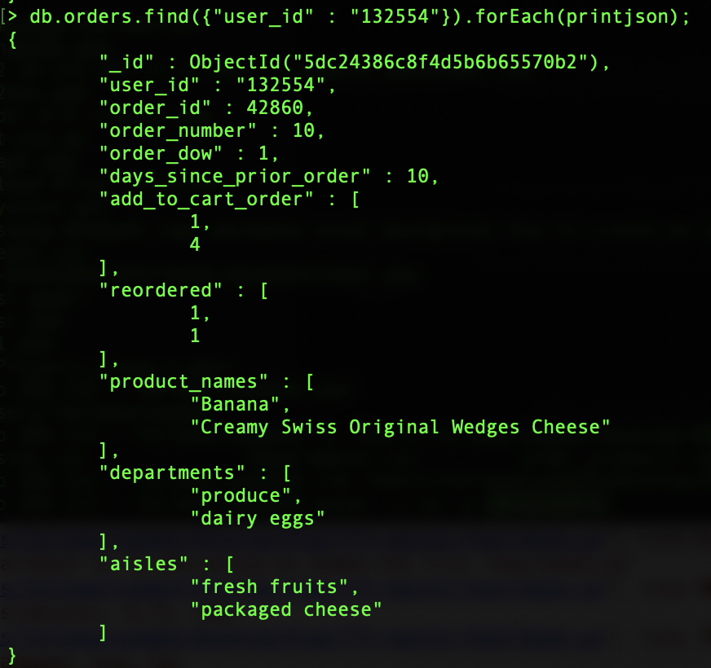
Results

Slide 13
Questions ?
Thanks

